Slide 1
Data analysis and Data visualization
for New York City Airbnb open data 2019 in R
CS 544 Project
PRESENTED BY : Pengfei Ma

Slide 2
Abstract
The major columns used in this project is the “neighborhood_group”, “price”, and “number of reviews”. And the goal of this project is exploring three information, three relationships and sampling for the data. Three information that want to be obtained is:
1. How many airbnbs in each borough, which has the most and which has the least?
2. Which borough has the highest price and which has the lowest?
3. What are their proportions?
The three relationships that this project want to explore is:
1. The relationship between price and location.
2. The relationship between price and minimum nights
3. The relationship between price and its location.
Three information exploration will use statistic calculation, probability functions to gain the result. Three relationships will use probability density function (PDF), cumulative density function (CDF), distribution analysis, and central limit theorem (CLT) to concern these relationships. Finally, the application of sampling on Airbnb open data will use sample random sampling, systematic sampling, inclusion probability and strata to show the result.
Keywords: Statistic functions, Plotting, RStudio, PDF, CDF, sampling, CLT

Slide 3
Project Map
Preparing Data
Picking the data set
Importing data
I
Categorical variable analysis of the number of airbnbs in different boroughs in NYC
1. Setting data
2. Visualization of airbnbs in each borough
Barplot of the number of airbnbs in each borough in NYC
Pie chart for the proportion of airbnbs in each borough
II

Slide 4
II. Numerical variable analysis of the price of airbnbs in NYC
1. Setting data
2. Visualization for the price
Barplot of the frequency of the price
Barplots of the frequency of the price in each borough
Summaries of the price in each borough
Boxplots of the price in each borough in one diagram
II
III. Comparation of the relationship between price, minimum night, number of reviews
Pairs diagram of the combination of the relationship of three variables
Scatterplot of the relationship of price and minimum night
Scatterplot for the relationship of price and number of reviews
Boxplots of price, minimum nights, and number of reviews
III

Slide 5
IV. Distribution Analysis
Plotting the data of number of reviews in airbnb open data
Scatterplot for the probability of each number of reviews appeared
Boxplot of the number of reviews
Summary of the number of reviews and its standard deviation
Probability density function for the number reviews as normal distribution
Cumulative distribution function for the number reviews as normal distribution
IV
V. Applicability of the Central Limit Theorem for Price
Setting data
Central Limit Theorem visualization for price
Histogram for CLT of sample size 10, 20, 30, 40 for price
Central Limit Theorem visualization for each borough
CLM for Manhattan
CLM for Brooklyn
CLM for Bronx
CLM for Queens
CLM for Staten Island
V

Slide 6
VI. Sampling for airbnb open data
Setting data
Sample random sampling
Table of 5000 random variables drew in Airbnb
Barplot of 5000 random variables drew in Airbnb
Table of proportion of random variables drew in each borough
Pie chart of the proportion of random variables drew in each borough
Systematic sampling
Table of systematic sampling with size = 5000 for each borough
Barplot of systematic sampling with size = 5000 for each borough
Table of the proportion of systematic sampling with size = 5000 for each borough
Pie chart of the proportion of systematic sampling with size = 5000 for each borough
Sampling for airbnb open data
4. Inclusion probability
Table of inclusion probability
Barplot of inclusion probability
Table of the proportion of inclusion probability of the number of airbnbs
Pie chart for the proportion of inclusion probability of the number of airbnbs
5. Stratified
Setting data
Table and description of stratified
VI
VI
Conclusion
&
References

Slide 7
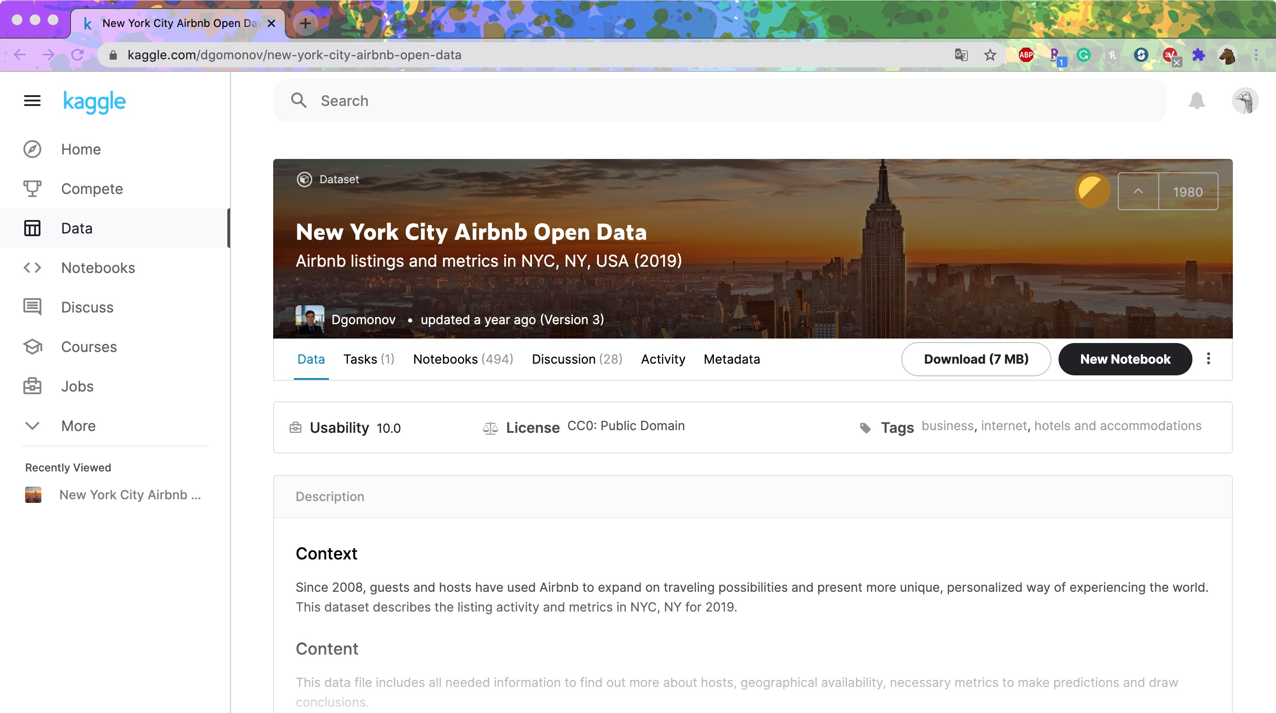
Preparing Data
1. Picking the data set
Kaggle
https://www.kaggle.com/dgomonov/new-york-city-airbnb-open-data
The New York City Airbnb Open Data by author Dgomonov which was updated in 2019 will be considered as the primary data set in this project.
The AB_NYC_2019.csv file is the only data file used in this project.
Client : 18 Conejos
Task : Logo Design
Skills : Photoshop, Illustrator

Slide 8
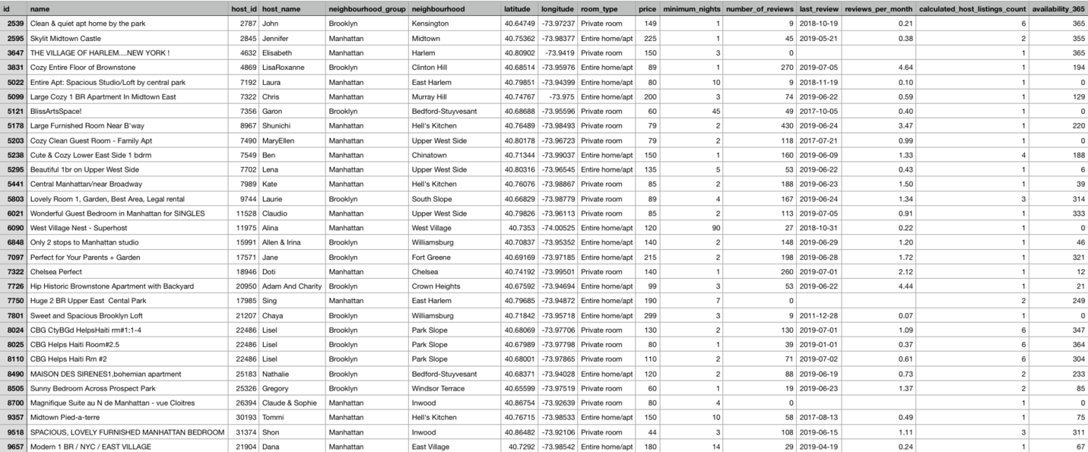
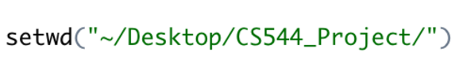
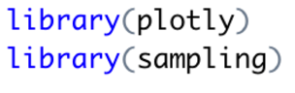
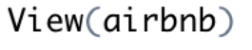
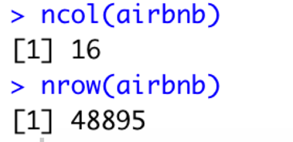
Preparing Data
2. Importing Data
Firstly, downloaded the AB_NYC_2019.csv file from https://www.kaggle.com/dgomonov/new-york-city-airbnb-open-data?select=AB_NYC_2019.csv into one folder on desktop named CS544_project.
Importing data and assigning data to name “airbnb”
Setting the packages (plotly, sampling) that will be used in this project

Slide 9
Data Analyzing
I. Categorical variable analysis of the number of airbnbs in different boroughs in NYC
1. Setting data
Firstly, assigning the number of airbnbs in different boroughs with the name of boroughs in NYC to “names_groupsInNYC”.
Secondly, gaining only the number of airbnbs in each borough and assign it to “numberOfAirbnbs”.
Finally, calculating the proportion of the number of airbnbs in the whole NYC, and assign to name “proportionEachBoroughs”.

Slide 10
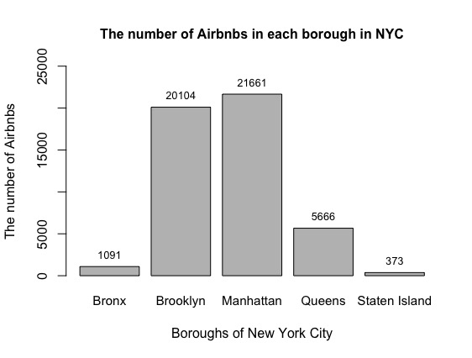
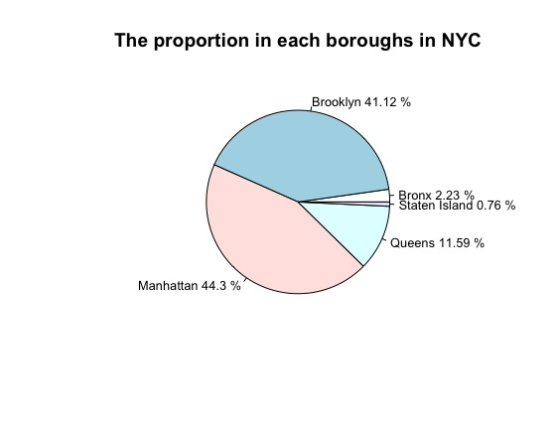
Data Analyzing
I. Categorical variable analysis of the number of airbnbs in different boroughs in NYC
2. Visualization of airbnbs in each borough
Barplot of the number of airbnbs in each borough in NYC
Pie chart for the proportion of airbnbs in each borough

Slide 11
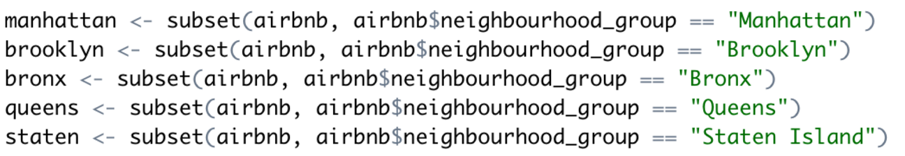
Data Analyzing
II. Numerical variable analysis of the price of airbnbs in NYC
1. Setting data
Creating the subset of 5 boroughs (Manhattan, Brooklyn, Bronx, Queens, Staten Island) and assign them to names “manhattan”, “brooklyn”, “bronx”, “queens”, “staten”.

Slide 12
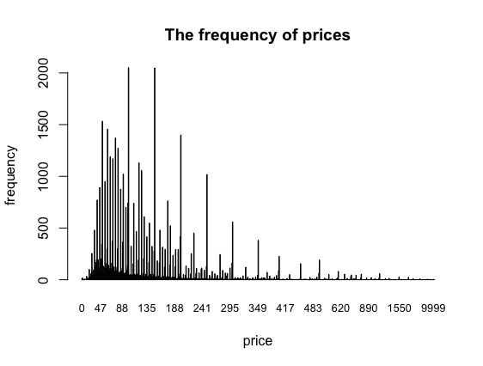
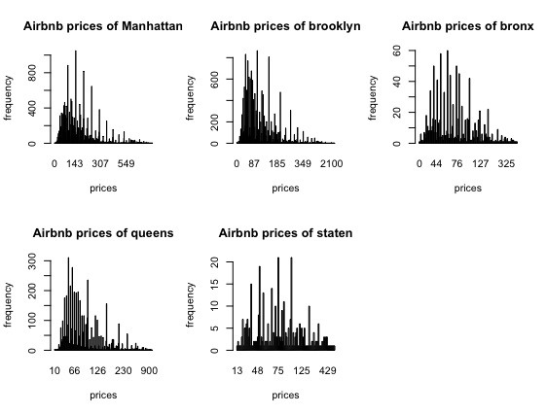
Data Analyzing
II. Numerical variable analysis of the price of airbnbs in NYC
2. Visualization for the price
Price
NYC
Boroughs

Slide 13
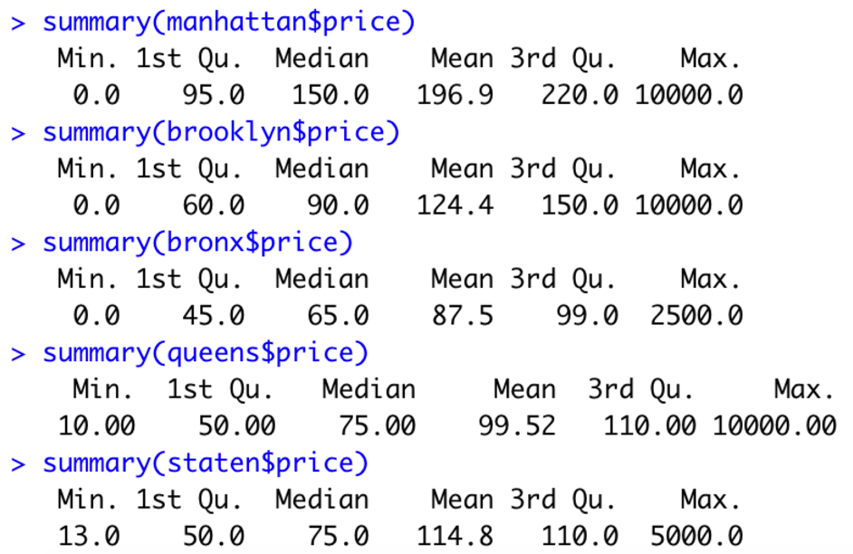
Data Analyzing
II. Numerical variable analysis of the price of airbnbs in NYC
Summaries of the price in each borough
Means
Max: Manhattan – 196.9
Min: Bronx – 87.5
Min.
Manhattan – 0.0
Brooklyn – 0.0
Bronx – 0.0
Median
Max: Manhattan – 150
Min: Bronx – 65
Max
Manhattan – 10000
Brooklyn – 10000
Queens – 10000
Manhattan has the highest mean, which imply that the average price of airbnb in Manhattan is the biggest. Conversely, Bronx has the lowest average price. Moreover, by looking at the median of each summary, it maintains the same results that Manhattan has the largest number and Bronx has the lowest.

Slide 14
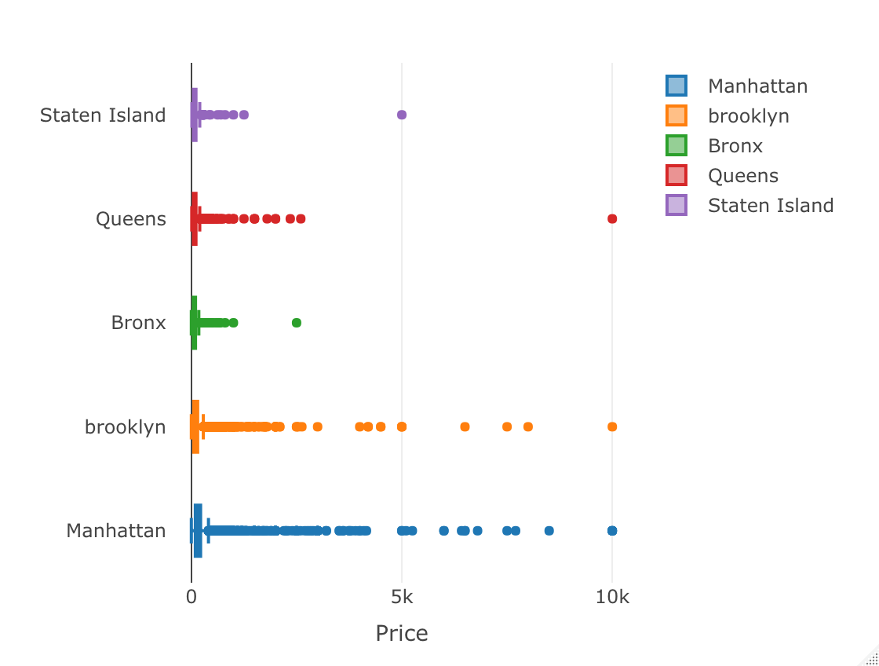
Data Analyzing
II. Numerical variable analysis of the price of airbnbs in NYC
Boxplots of the price in each borough in one diagram
By using package “plotly”, do the data visualization. Combining boxplots of five columns of the data into one diagram to see their quantiles, outliers, and six statistical data.

Slide 15
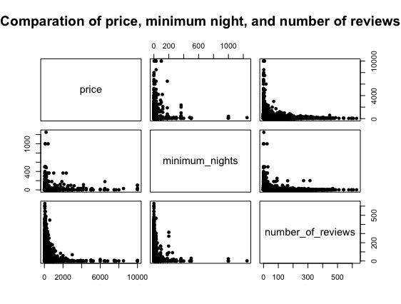
Data Analyzing
III. Comparation of the relationship between price, minimum night, number of reviews
Price ~ Minimum Nights
1.Pairs diagram of three variables
Min night ~ num of review
More minimum nights need, lower price will be offered. And converse to be true that higher price gives less need of minimum nights.
More number of reviews implies fewer minimum nights. Moreover, more minimum nights needed, a smaller number of reviews provided.
Price ~ Number of reviews
Conclusion
More number of reviews, then the price gets lower. Conversely, higher price gets a smaller number of reviews.
Price is negatively related to minimum nights and number of reviews. Minimum nights are negatively related to number of reviews as well.

Slide 16
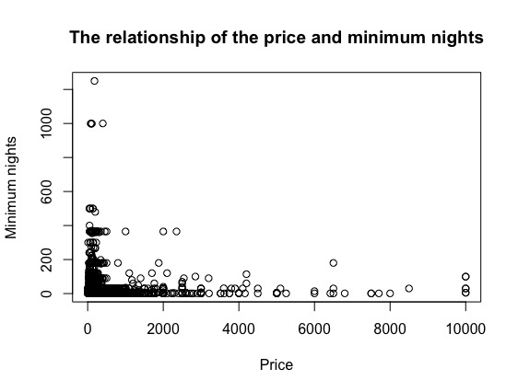
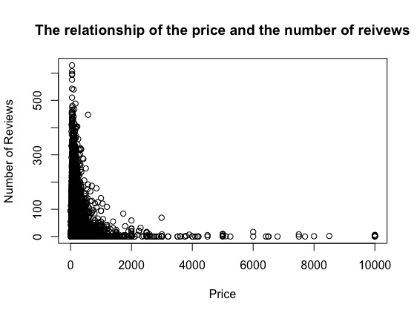
Data Analyzing
III. Comparation of the relationship between price, minimum night, number of reviews
2 & 3. Scatterplot of price to minimum nights and number of reviews
Scatterplot of the relationship of price and minimum nights
Scatterplot for relationship of price and number of review

Slide 17
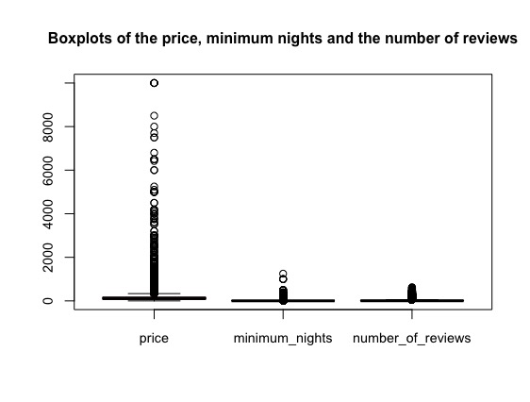
Data Analyzing
III. Comparation of the relationship between price, minimum night, number of reviews
4. Boxplots of price, minimum nights, and number of reviews
Applying the combination of boxplots of these three data to see their statistical number.

Slide 18

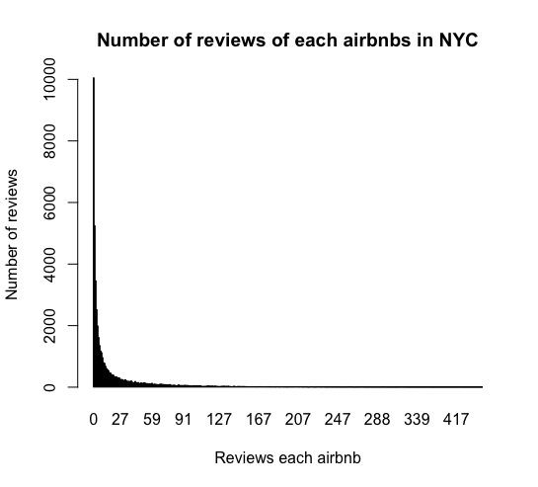
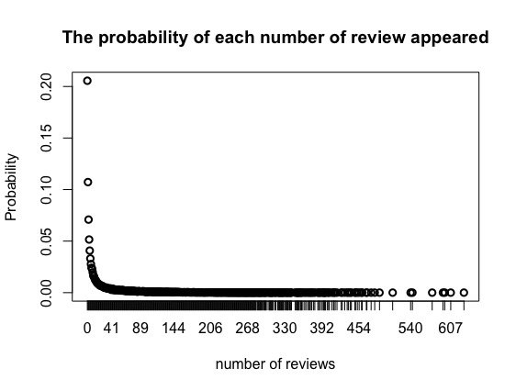
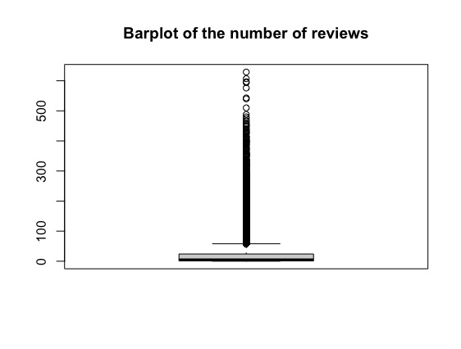
Data Analyzing
IV. Distribution Analysis
1 & 2 & 3. Plotting for number of reviews
Plotting the data of number of reviews in airbnb open data
Scatterplot for the probability of each number of reviews appeared
Boxplot for the number of reviews

Slide 19
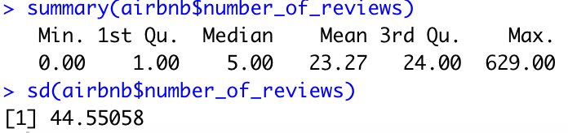
Data Analyzing
IV. Distribution Analysis
4. Summary of the number of reviews and its standard deviation
This is the six statistical number and standard deviation of number_of_reviews by using summary() and sd() functions.

Slide 20
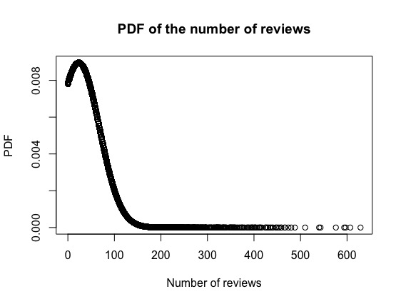
Data Analyzing
IV. Distribution Analysis
5. Probability density function for the number reviews as normal distribution
Inference
More probabilities concentrated on [0,300], and the density is increasing from 0 to 600. As a result, an airbnb has a higher probability to receive fewer reviews.
Probability density is decreasing.
Less possible to get more reviews.
higher probability to receive fewer reviews.

Slide 21
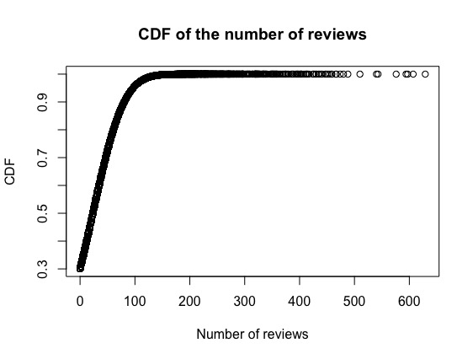
Data Analyzing
IV. Distribution Analysis
6. Cumulative distribution function for the number reviews as normal distribution
Inference
With the increasing number of reviews, the probability is decreasing declining significantly. With the decreasing of the slope, the probability is decreasing. Also, the density is decreasing with the increasing number of reviews.
Probability density is decreasing.
Slope is decreasing.
Number of reviews are decreasing.
Probability of getting more number of reviews is decreasing.

Slide 22
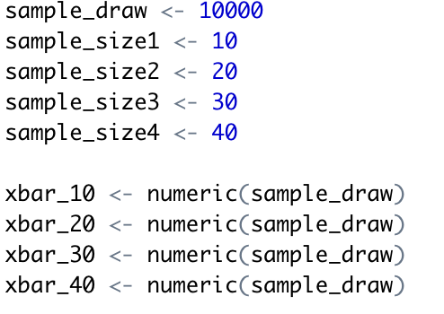
Data Analyzing
V. Applicability of the Central Limit Theorem for Price
1. Setting data
Setting the data for central limit theorem. In this part, 4 different sample size 10, 20, 30, 40 will be used for each one method to do the data visualization for price of the whole NYC, and for each borough. 10000 samples will be draw randomly with replacement and equal probability.

Slide 23
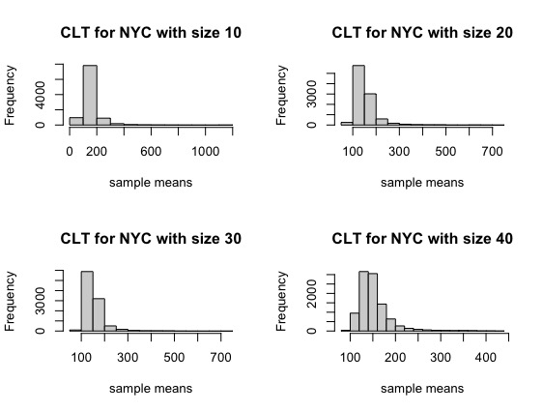
Data Analyzing
V. Applicability of the Central Limit Theorem for Price
2. CLT visualization by Histogram of NYC with sample size 10, 20, 30, 40 for price
Mean
Diagrams
Distribution
The means are all focus on 100 to 200.
Right-skewed
Normal distribution

Slide 24
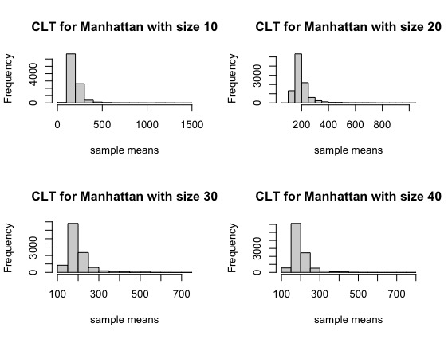
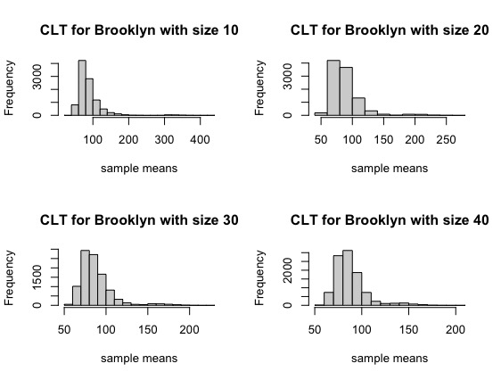
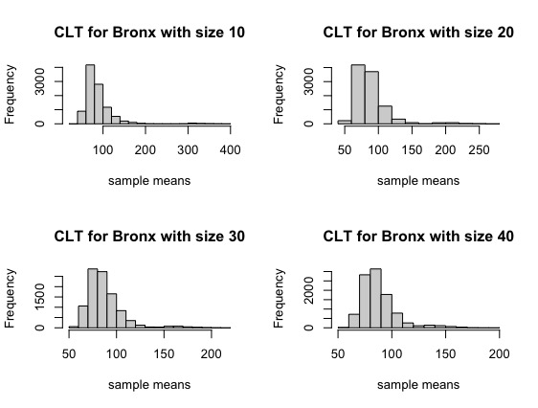
Data Analyzing
V. Applicability of the Central Limit Theorem for Price
CLT visualization by Histogram of Manhattan, Brooklyn, and Bronx with sample size 10, 20, 30, 40 for price
01
02
03
Manhattan
Central Limit Theorem applied for Manhattan.
Brooklyn
Central Limit Theorem applied for Brooklyn.
Bronx
Central Limit Theorem applied for Bronx.

Slide 25
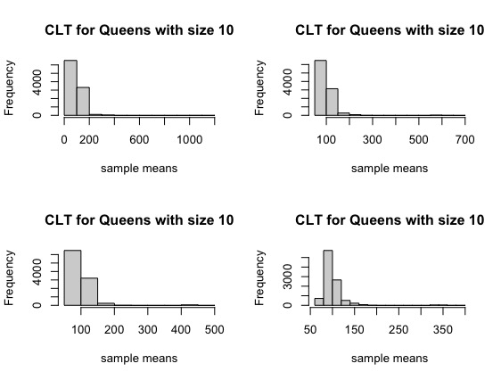
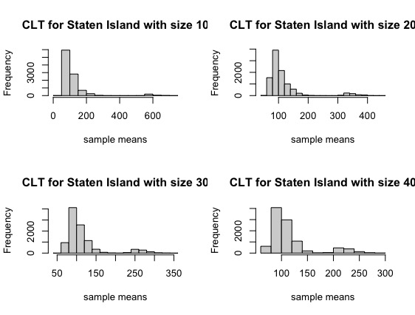
Data Analyzing
V. Applicability of the Central Limit Theorem for Price
CLT visualization by Histogram of Queens and Staten Island with sample size 10, 20, 30, 40 for price
04
05
Queens
Central Limit Theorem applied for Queens.
Staten Island
Central Limit Theorem applied for Staten Island.

Slide 26
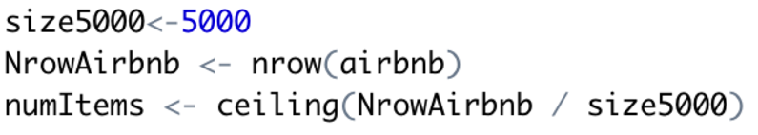
Data Analyzing
VI. Sampling for airbnb open data
1. Setting data
Randomly draw 5000 samples from the whole airbnb data set by using sampling method to draw different samples.

Slide 27
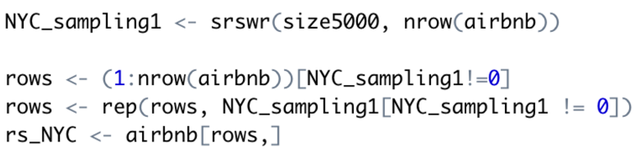
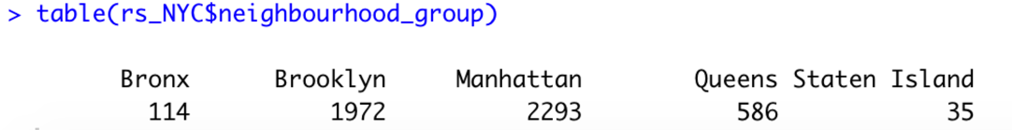
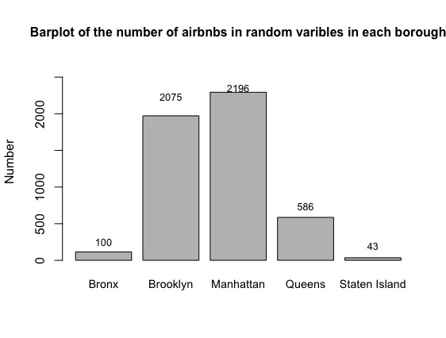
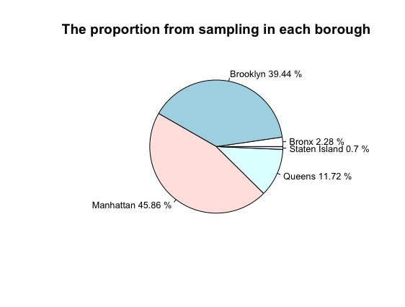
Data Analyzing
VI. Sampling for airbnb open data
2. Sample random sampling and visualization of 5000 samples
Sample random sampling
By using sample random sampling, 5000 samples were drawing. By table() function, it shows that 114 samples from Bronx, 1972 samples from Brooklyn, 2293 samples from Manhattan, 586 samples from Queens, and 35 samples from Staten Island.
Barpolot of 5000 random
variables drew in airbnb
Pie chart of the proportion
of random variables drew
in each borough

Slide 28
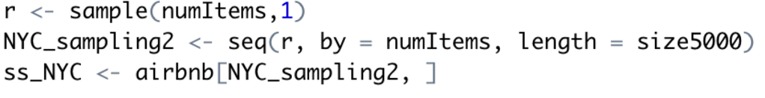
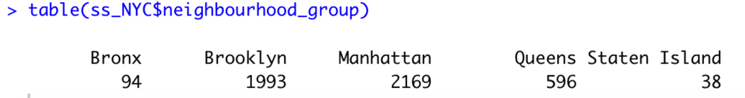
Data Analyzing
VI. Sampling for airbnb open data
3. Systematic sampling and visualization of 5000 samples
Systematic sampling
Barpolot of 5000 random
variables drew in airbnb
Pie chart of the proportion
of random variables drew
in each borough

Slide 29
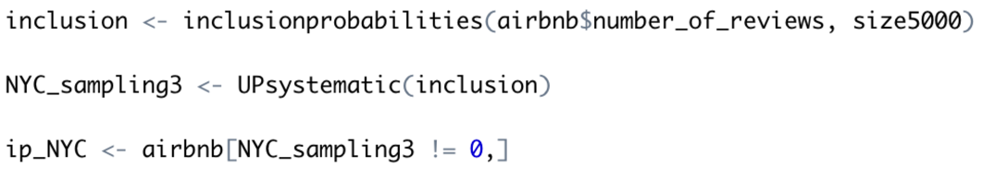
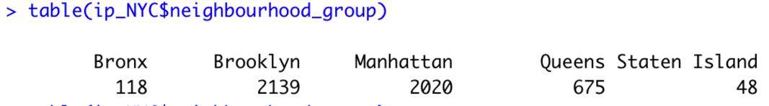
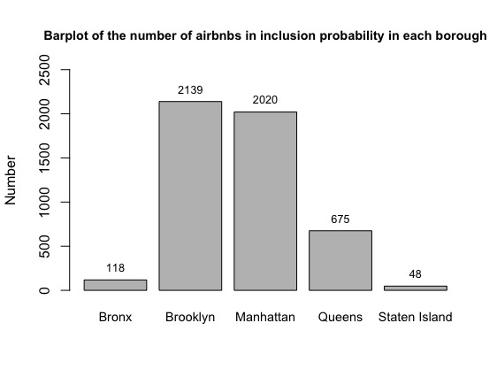
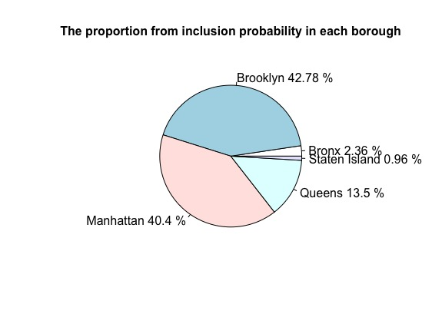
Data Analyzing
VI. Sampling for airbnb open data
4. Inclusion probability and visualization of 5000 samples
Inclusion probability
Barpolot of 5000 random
variables drew in airbnb
Pie chart of the proportion
of random variables drew
in each borough

Slide 30
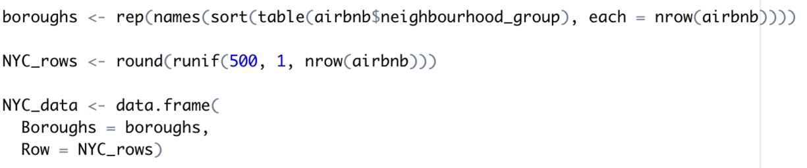
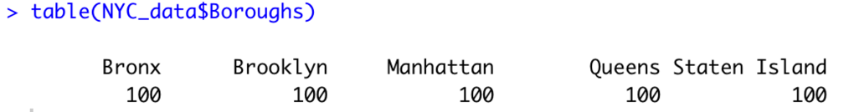
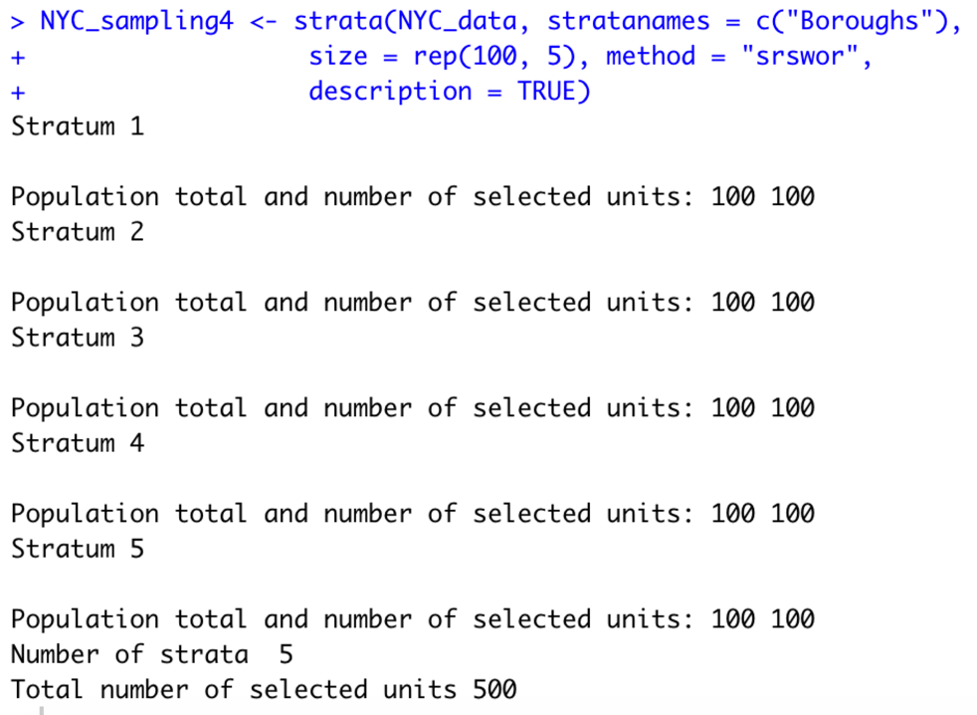
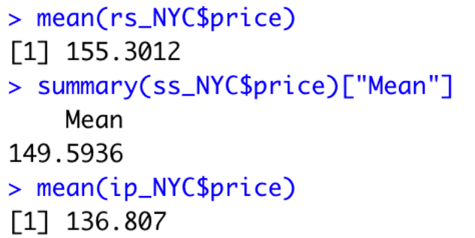
Data Analyzing
VI. Sampling for airbnb open data
5. Stratra
Setting data
Table of stratified data
Strata function for airbnb open data with 500 sample size
Mean comparasion

Slide 31
Conclusion
Module 3
Module 4
1091 airbnbs in Bronx, 20104 airbnbs in Brooklyn, 21661 airbnbs in Manhattan, 5666 airbnbs in Queens, and 373 airbnbs in Staten Islands.
From pairs diagram. More minimum nights need, lower price will be offered. And converse to be true that higher price gives less need of minimum nights.
In addition, a greater number of reviews, then the price gets lower. Conversely, higher price gets a smaller number of reviews.
Lastly, for minimum_nights and number_of_reviews. More number of reviews implies fewer minimum nights. Moreover, more minimum nights needed, a smaller number of reviews provided.
Manhattan has the largest number of airbnbs which is 21661. Staten Island has the least number of airbnbs which is 373. Eventually, Manhattan occupied the most percentage of the number of airbnbs which is 44.3%. Brooklyn is NO.2 which has 41.12%. Queens has 11.59%. Bronx has 2.23%. And Staten Island has the least percentage, which is 2.23%.

Slide 32
Conclusion
Module 4 distribution
Module 5 CLT
From distribution analysis, it is less possible to get more reviews. The probability is decreasing. From the diagram of the probability density function, it implies that more probabilities concentrated on [0,300], and the density is increasing from 0 to 600. As a result, an airbnb has a higher probability to receive fewer reviews.
From cumulative density function, the increasing number of reviews, the probability is decreasing declining significantly. With the decreasing of the slope, the probability is decreasing. Also, the density is decreasing with the increasing number of reviews.
Applying central limit theorem to the whole data set and each borough, it could be determined that the price column is a left-skewed diagram. From the large data set airbnb, the sample means are normal distributed. And it is normal distributed in all four sample sizes. Next step, applying central limit theorem to each borough and doing data visualization for each one.
Module 5 sampling
Four sampling methods used in this project, sample random sampling, systematic sampling, inclusion probability, and strata. Generating 5000 samples from the whole airbnb data set. By comparing the mean of the first three sampling methods, the means are decreasing a little.

Slide 33
References
D. (2019, August 12). New York City Airbnb Open Data. Kaggle. https://www.kaggle.com/dgomonov/new-york-city-airbnb-open- data?select=AB_NYC_2019.csv
Kalathur, S. (2020, October 7). CS 544 Module 5. BU CS544. https://onlinecampus.bu.edu/bbcswebdav/pid-7953809-dt-content-rid- 40368175_1/courses/20fallmetcs544_o1/course/module5/allpages.htm
Kalathur, S. (2020, September 30). CS 544 Module 4. BU CS544. https://onlinecampus.bu.edu/bbcswebdav/pid-7953808-dt-content-rid- 40368145_1/courses/20fallmetcs544_o1/course/module4/allpages.htm
Kalathur, S. (2020, September 23). CS 544 Module 3. BU CS544. https://onlinecampus.bu.edu/bbcswebdav/pid-7953807-dt-content-rid- 40368122_1/courses/20fallmetcs544_o1/course/module3/allpages.htm

Slide 34
THANKS FOR
WATCHING!

